Slide 1
“ChromNet”
Caleb Lareau

Slide 2
Drawbacks of CellNet
Only handles microarray
No RNA-Seq
No strong comparison with simpler computational methods
PCA space distance, etc.
Using expression to identify transcription factors of interest
Chromatin clusters cell populations better

Slide 3
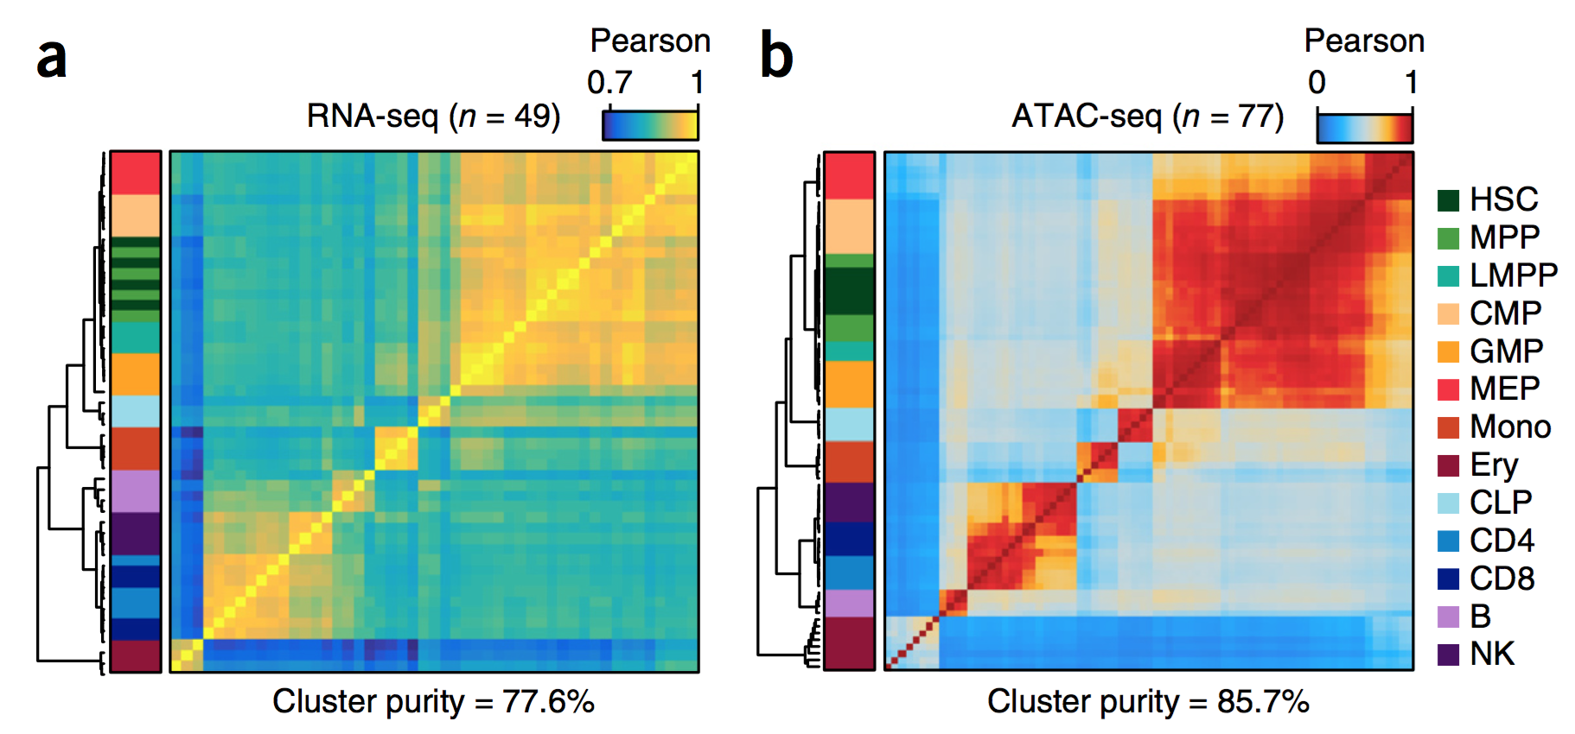
Corces et al. 2016

Slide 4
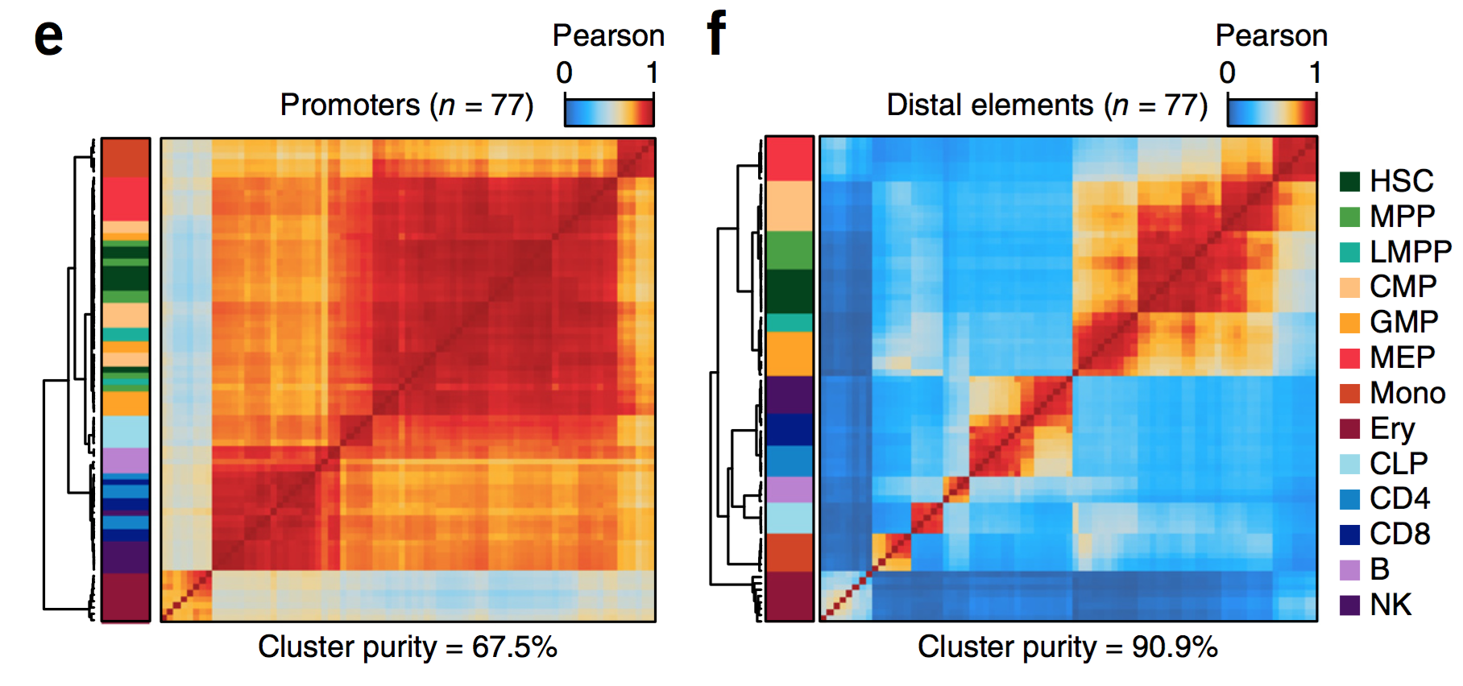
Corces et al. 2016

Slide 5
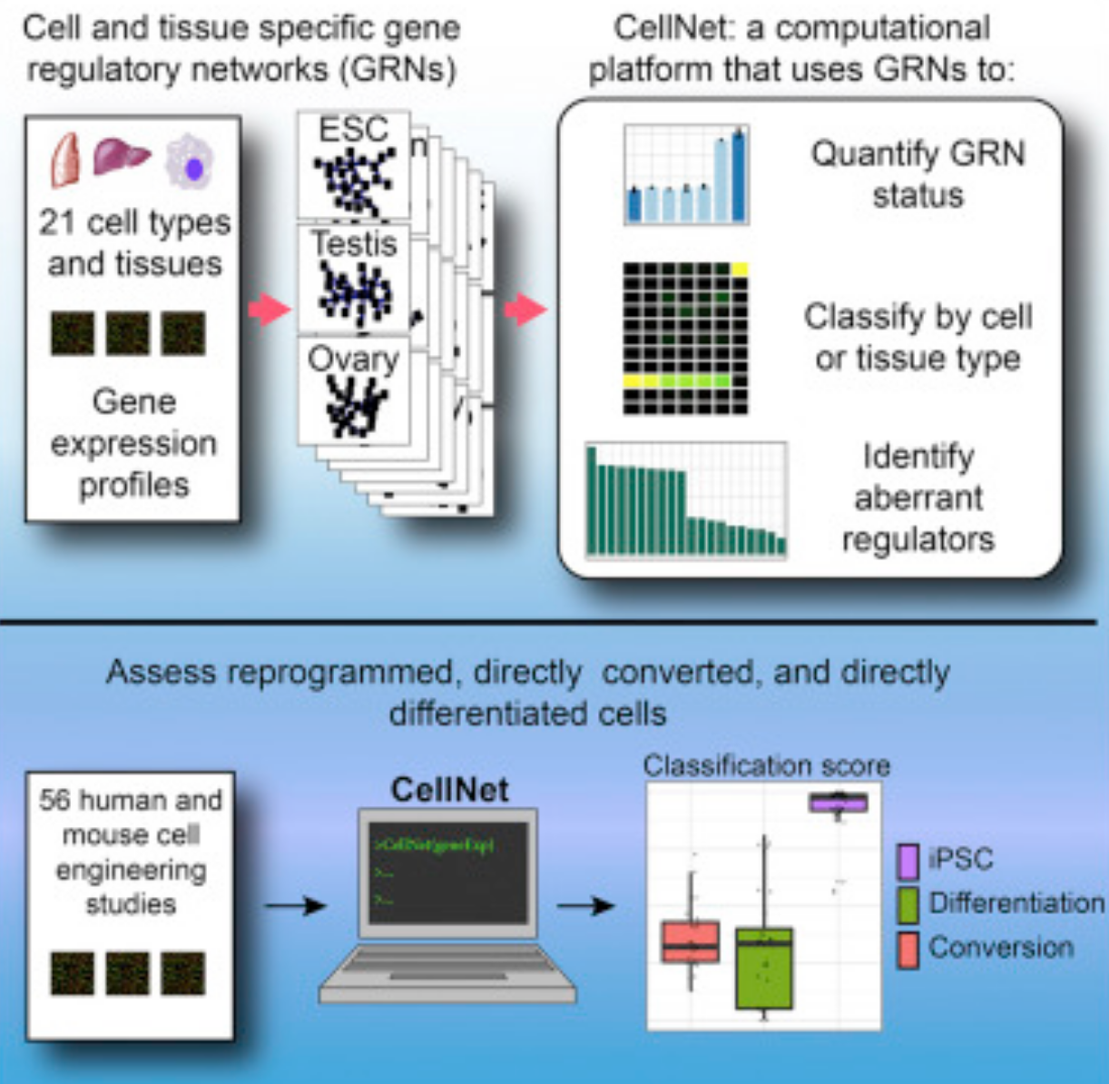

Slide 6
ChromNet:
Principle components?
chromatin
similarity
Signature
Hundreds!
Signature
Open
Chromatin
Signature
!!!!
?
ChromNet

Slide 7
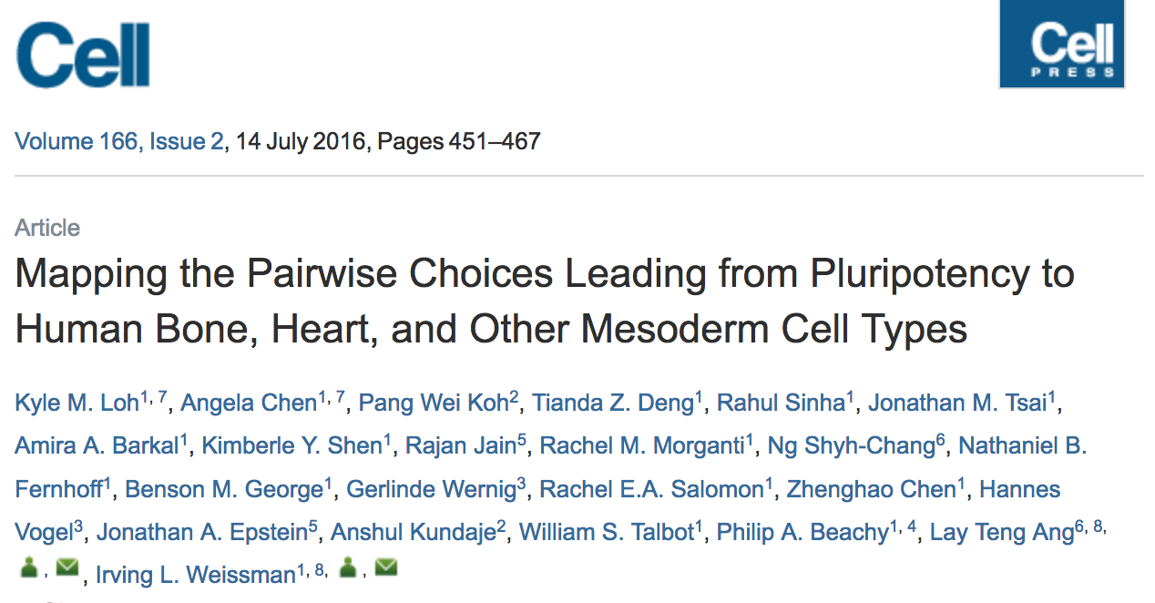

Slide 8
1. Question
Can we develop an effective computational methodology to separate cellular phenotypes based on their chromatin profiles?

Slide 9
2. Data
Primary: GEO bulk ATAC Data
Secondary: iPSC ATAC (< 500 cells)
Secondary: scATAC

Slide 10
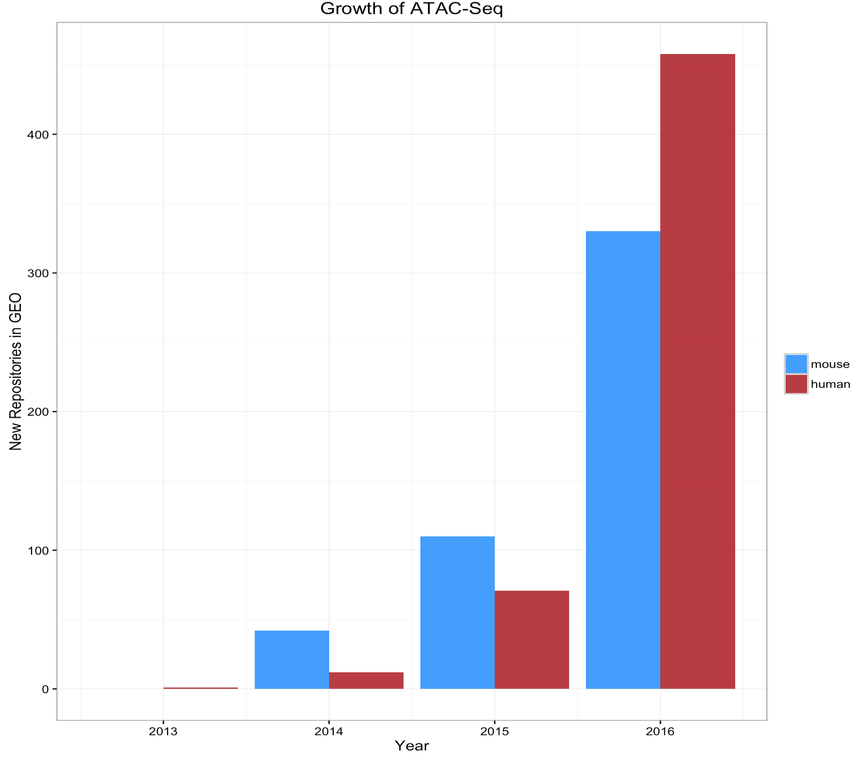

Slide 11
3. Methods
Principal component
tSNE
CellNet-like approaches

Slide 12
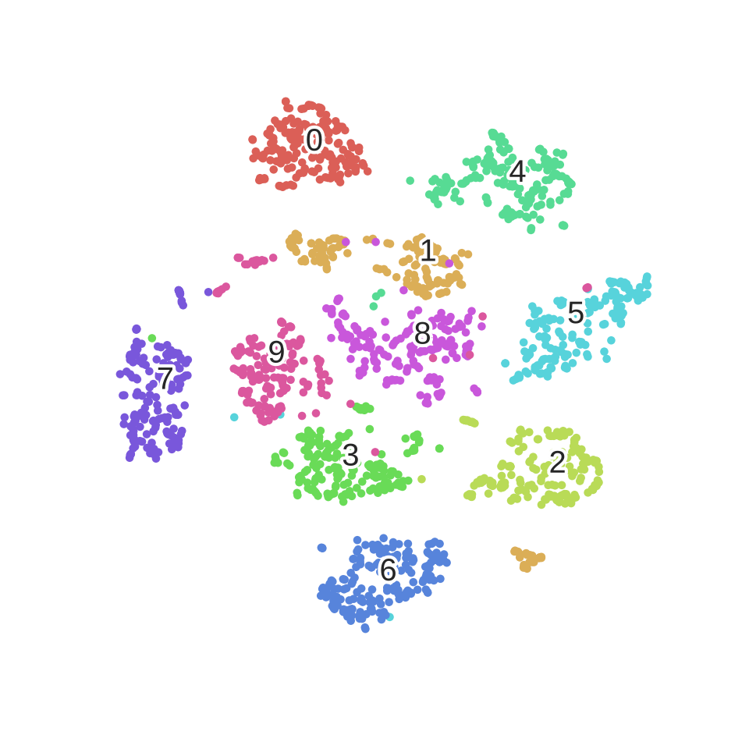

Slide 13
4. Results
Measures of variability in single cells
Effectiveness of iPSC conversions
Identification of TFs that mediate cellular phenotypes

Slide 14
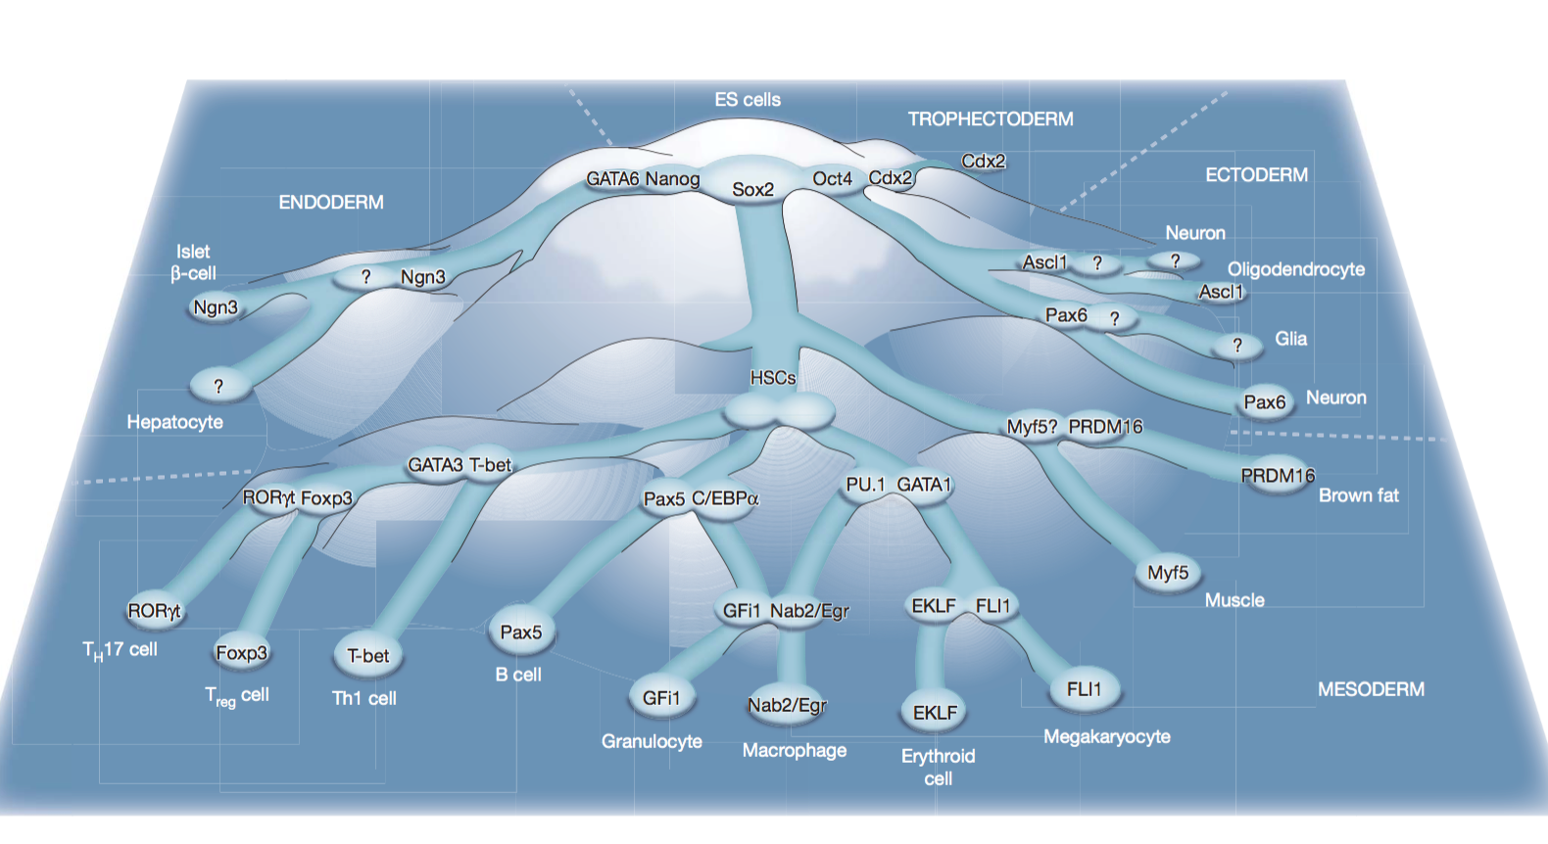

Slide 15
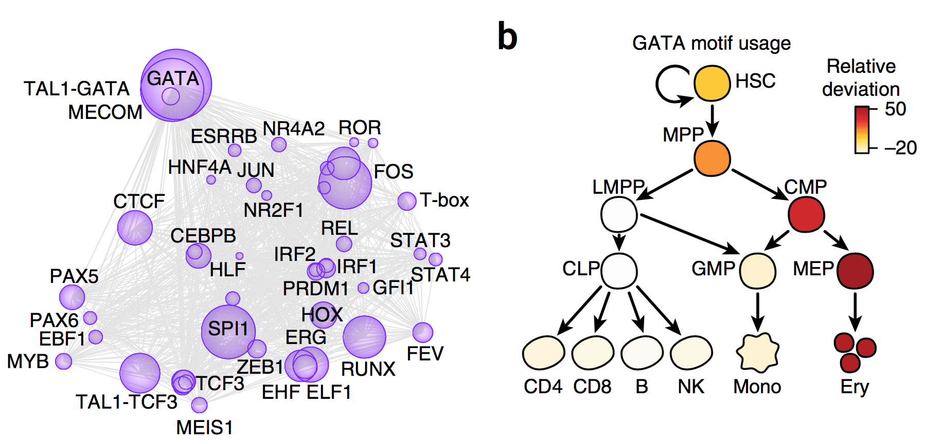
5. Interpretation
Corces et al. 2016

Slide 16
6. Validation
TF clone knock-ins
TF knock outs

Slide 17
Discussion

